Slide 1
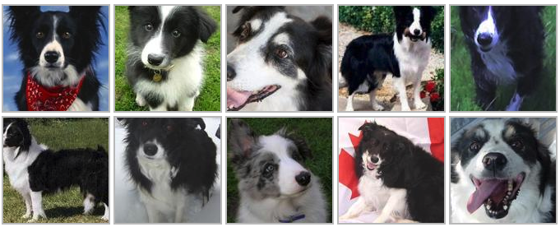
Capstone Project III Establishing Images Classification System by Convolutional Neural Network (CNN) Lok Hang Ronald, Wong

Slide 2

Background Information
Image classification is one of the hottest topics in ML’s world
The usages of image classification are wide and significant in many academic subjects
Computer Science (Graphics, Algorithms, Theory, Systems, Architecture)
Mathematics (Information Retrieval, Machine Learning)
Engineering (Robotics, Speech, NLP, Image Processing)
Physics (Optics), Biology (Neuroscience)
Psychology (Cognitive Science).

Slide 3
Aims and Objectives
Establish a CNN model which can classify 20 types of dog breeds from the labelled images
The established model can serve as baseline model which can apply for different kinds of classification problems, i.e.
Vehicles Image Classification
Face Recognition
X-ray (or other medical images) Diagnosis

Slide 4
Dataset
The original data source is found on http://vision.stanford.edu/aditya86/ImageNetDogs/
Created by Aditya Khosla et al.
The original data set contains:
Number of categories: 120
Number of images: 20,580
Annotations: Class labels, Bounding boxes
Due to computation power, this project reduces the problems to:
Number of categories: 20
Number of images: 3,629

Slide 5
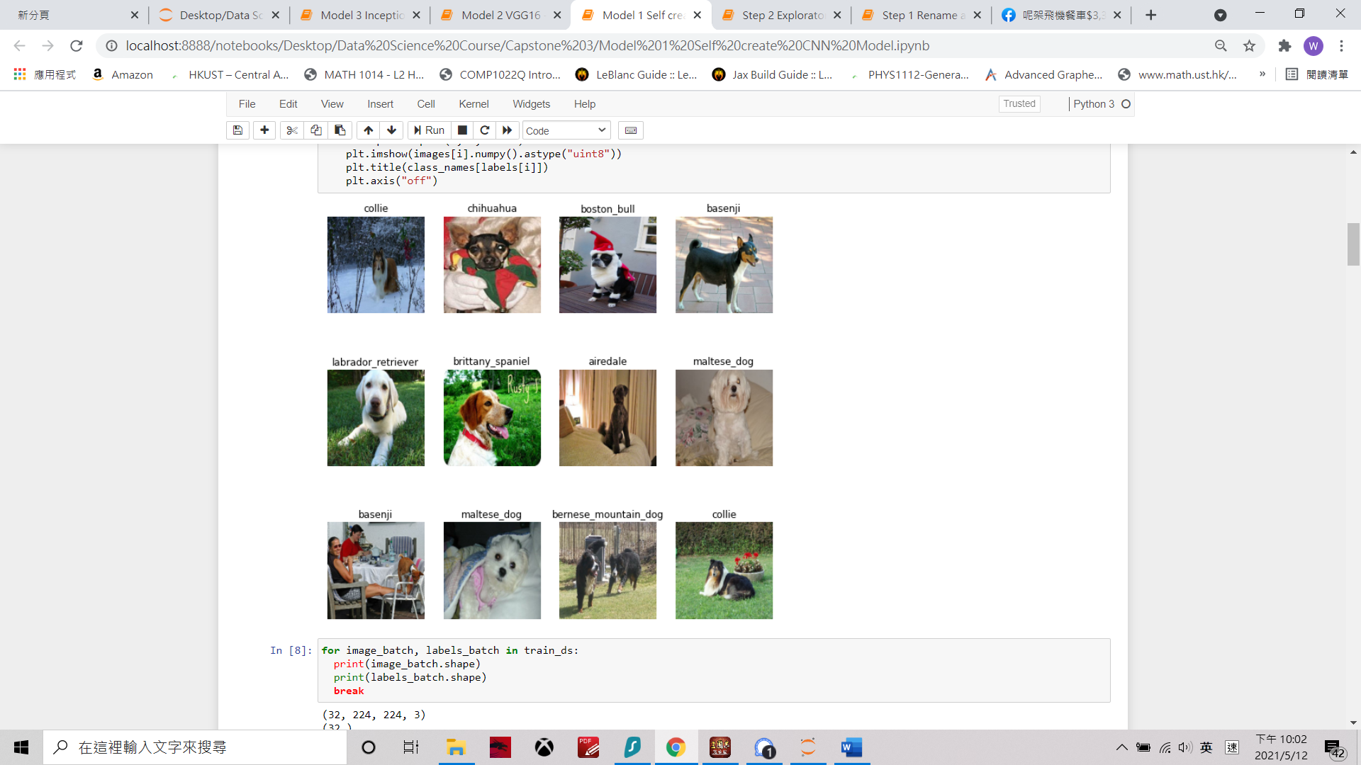
Dataset
Data Preview:

Slide 6
Project Outline
Data Wrangling
-Subset of 20 dog breeds
-Data Quality Checking
Exploratory Data Analysis (EDA)
-Check for unbalance class
-Data Visualization
Pre-processing and Training Data
-Re-size & augmentation
-Data splitting
Modeling
-Models Comparison
-VGG16, Inception V3 &
Self - customized CNN
Conclusion
-Confusion Matrix
-Precision & Recall

Slide 7
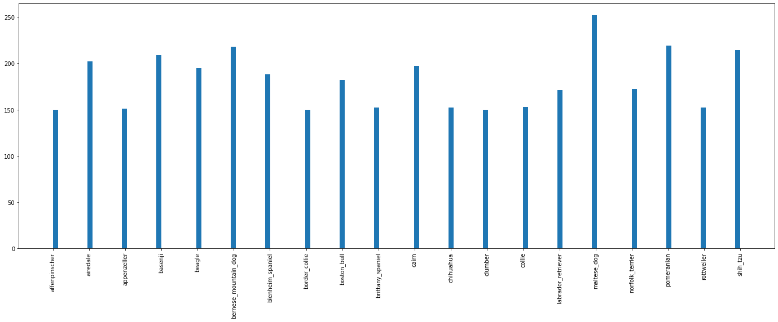
Exploratory Data Analysis (EDA) – Balanced Data

Slide 8
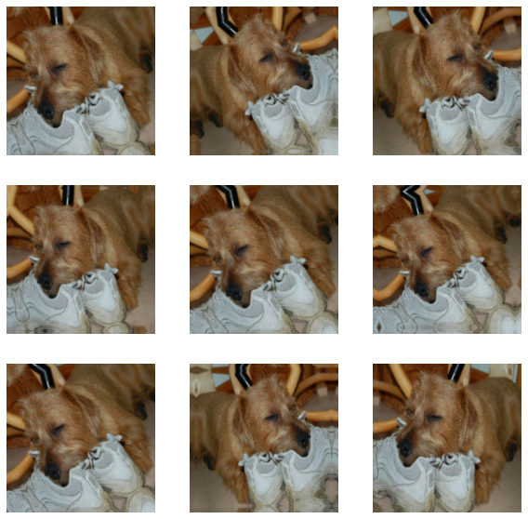
Data Preprocessing
Image Resize
Resize all image into identical width & height
Ensure all data will generate same number of neural nodes
Data Augmentation
cropping, padding, and rotation

Slide 9
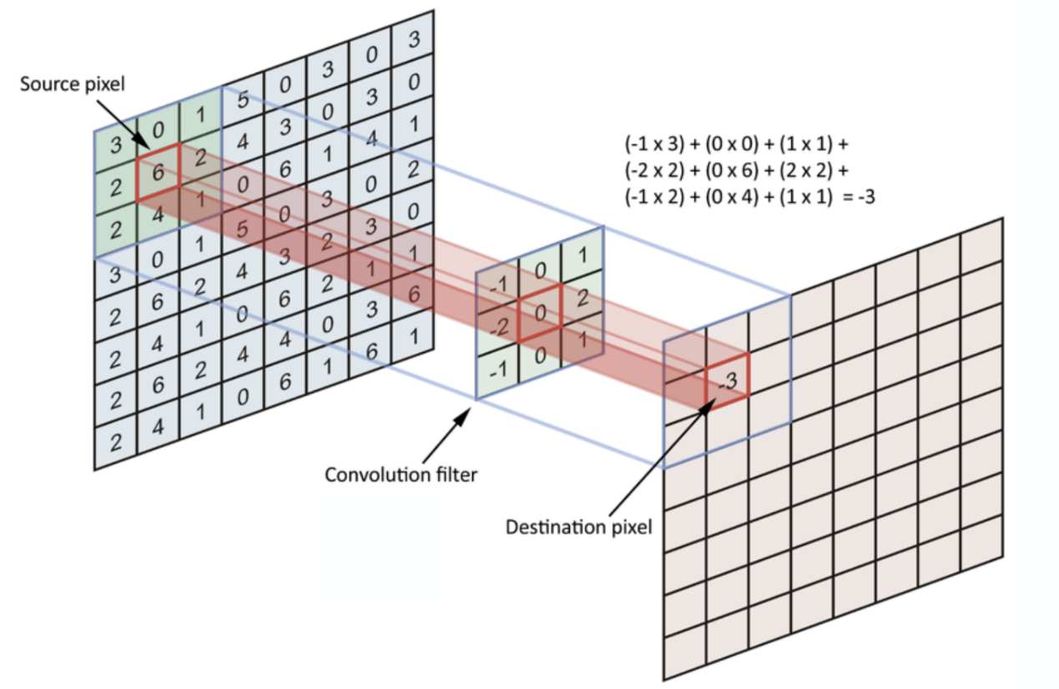
Convolution Neural Network (CNN) Model
Step 1 – Apply filter and activation function to input image
Source: https://towardsdatascience.com/simple-introduction-to-convolutional-neural-networks-cdf8d3077bac

Slide 10
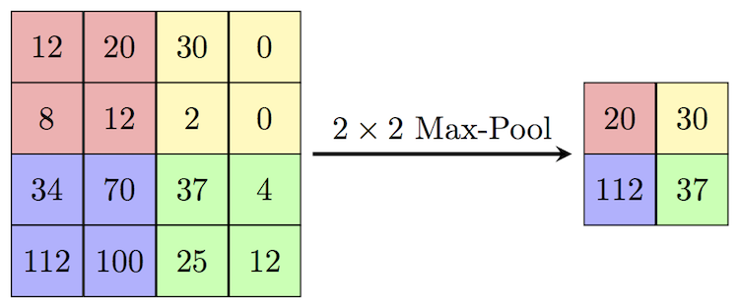
Convolution Neural Network (CNN) Model
Step 2 – Pooling
Source: https://computersciencewiki.org/index.php/Max-pooling_/_Pooling

Slide 11
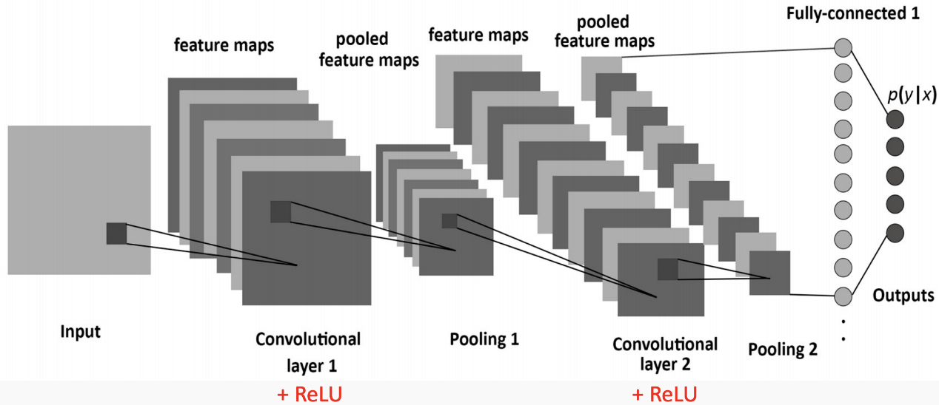
Convolution Neural Network (CNN) Model
Step 3 – Flattening (Fully Connected)
Source: https://towardsdatascience.com/simple-introduction-to-convolutional-neural-networks-cdf8d3077bac

Slide 12
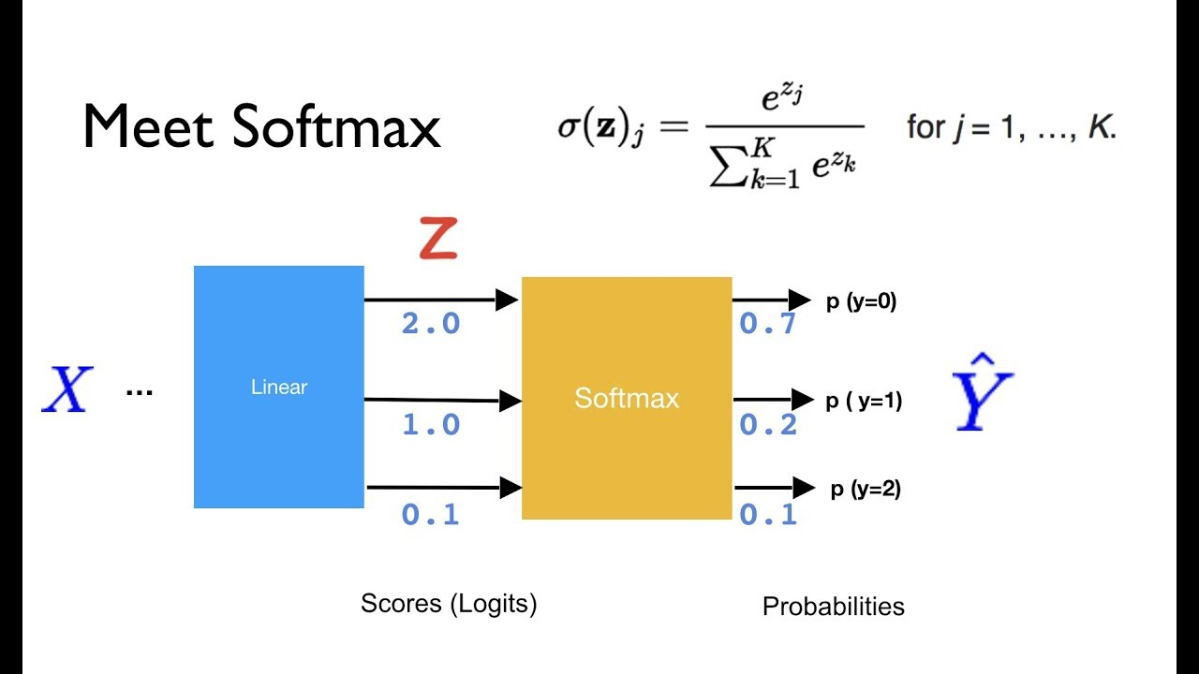
Convolution Neural Network (CNN) Model
Step 4 – Model training and Backpropagation
Softmax
Source: https://github.com/hunkim/PyTorchZeroToAll

Slide 13
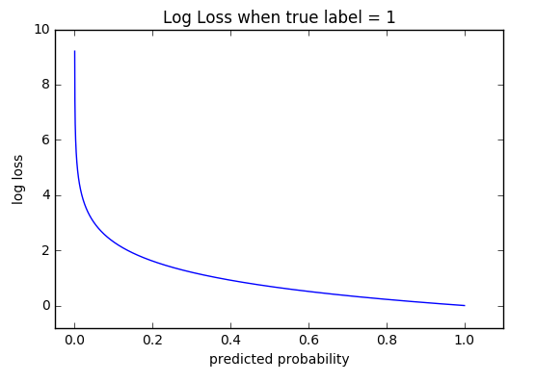
Convolution Neural Network (CNN) Model
Step 4 – Model training and Backpropagation
Crossentropy

Slide 14
Convolution Neural Network (CNN) Model
Step 5 – Tunning of Hyperparameter
Hyperparameter | Description
No. of Epoch | No. of times updating bias and weighting of CNN
Learning rate | Step size of each epoch
Activation Function | Fitting function mapping input and output
Dropout | %, no. and position of network dropout
No. of layer | Combination of Step 1 & Step 2
Filter | Size & padding of filters

Slide 15
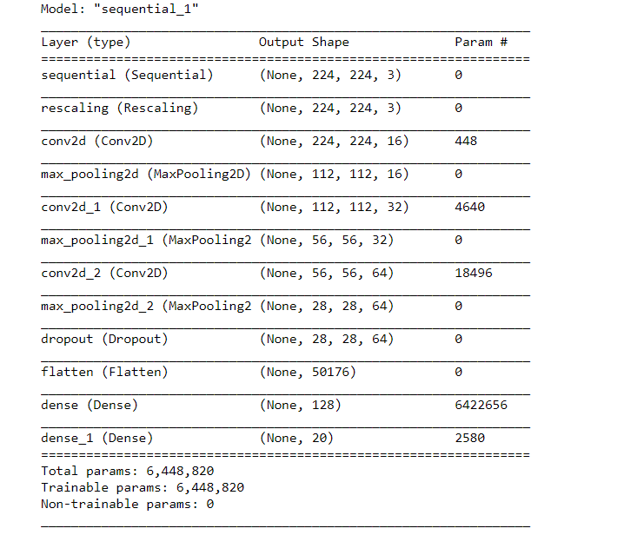
Model 1 - Self-Customized CNN Model
Model Setting

Slide 16
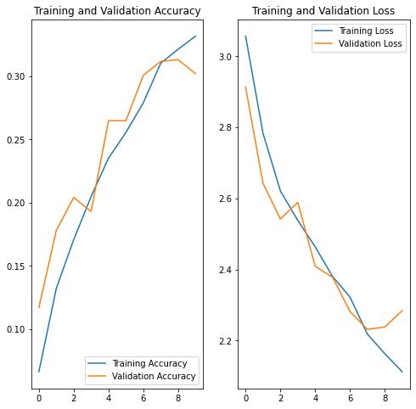
Model 1 - Self-Customized CNN Model
Result
30.2% Accuracy
on validation data

Slide 17
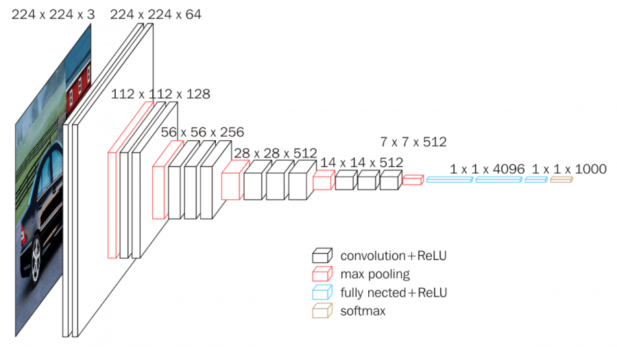
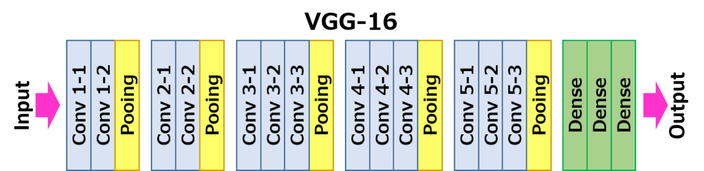
Model 2 - VGG16 Model
Developed by by K. Simonyan and A. Zisserman from the University of Oxford

Slide 18
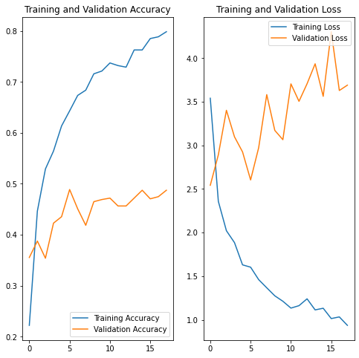
Model 2 - VGG16 Model
Result
48.7% Accuracy
on validation data

Slide 19
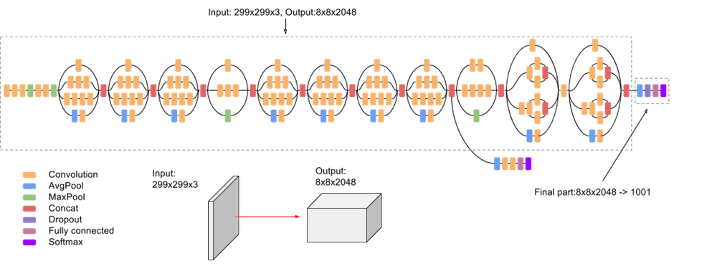
Model 3 – Inception V3 Model
The third edition of Google's Inception Convolutional Neural Network

Slide 20
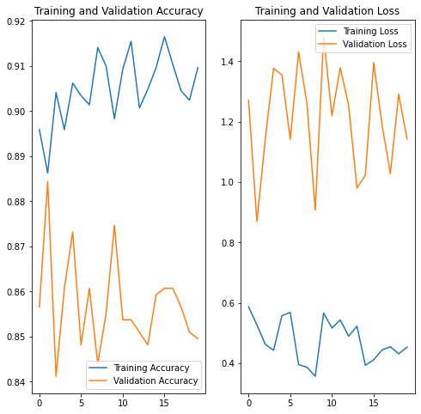
Model 3 – Inception V3 Model
Result
87.5% Accuracy
on validation data

Slide 21
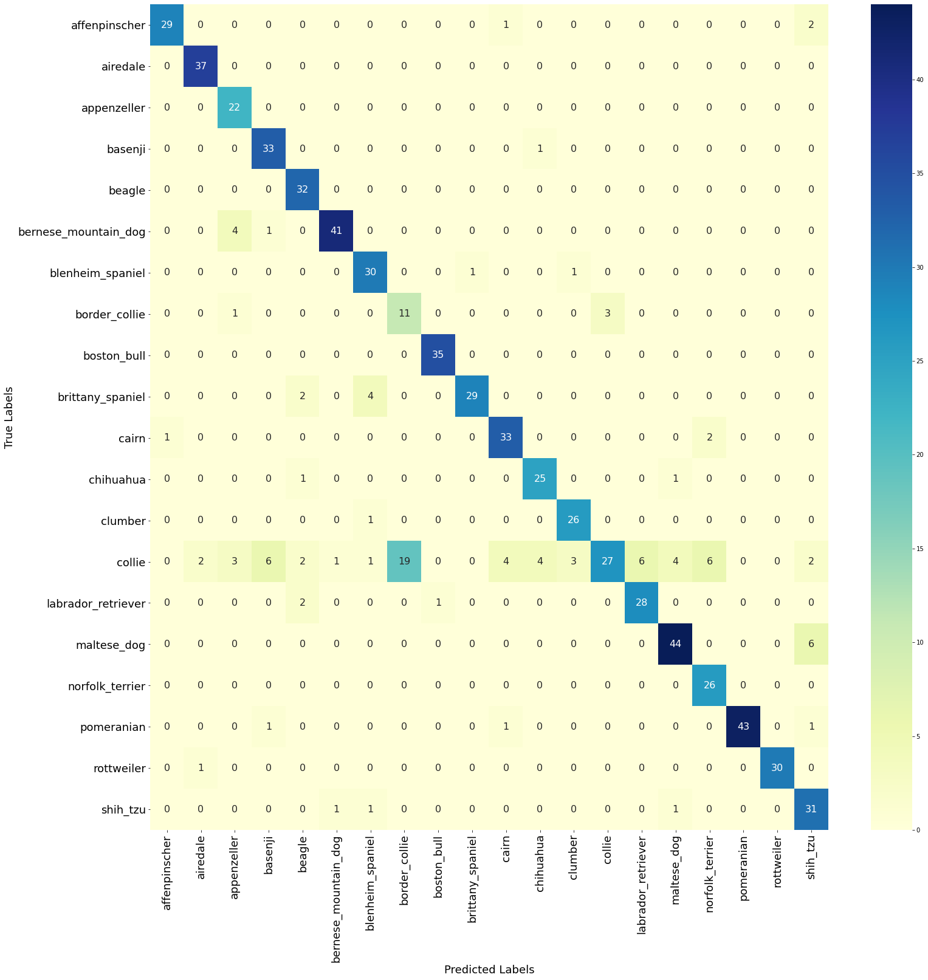
Model 3 – Inception V3 Model
Result
Confusion Matrix

Slide 22
Model 3 – Inception V3 Model
precision recall f1-score support
0 0.97 0.91 0.94 32
1 0.93 1.00 0.96 37
2 0.73 1.00 0.85 22
3 0.80 0.97 0.88 34
4 0.82 1.00 0.90 32
5 0.95 0.89 0.92 46
6 0.81 0.94 0.87 32
7 0.37 0.73 0.49 15
8 0.97 1.00 0.99 35
9 0.97 0.83 0.89 35
10 0.85 0.92 0.88 36
11 0.83 0.93 0.88 27
12 0.87 0.96 0.91 27
13 0.90 0.30 0.45 90
14 0.82 0.90 0.86 31
15 0.88 0.88 0.88 50
16 0.76 1.00 0.87 26
17 1.00 0.93 0.97 46
18 1.00 0.97 0.98 31
19 0.74 0.91 0.82 34
accuracy 0.85 718
macro avg 0.85 0.90 0.86 718
weighted avg 0.87 0.85 0.84 718
Result
Classification Report

Slide 23
Future Studies
Google Colab or other methods can be applied to solve the computation problems.
Collie and border collie are performed bad in the best mode. Further studies can be carried for further improvement.
More time and effort can be used for tuning of hyperparameter
More problems can be solved by transforming models in this project. This project only provides baseline models for study and reference.

Slide 24
Conclusion
This project adopts CNN model to identify 20 dog breeds from their images and obtains an accuracy of 84.5% on validation data.
With the same CNN concepts but different combination of layers and hyperparameters. The result of model will have huge different.
Establish a baseline model and further transformation of the model can be performed to solve other real-world problems

Slide 25
Q & A

